Slide 1
Behçet’s Disease ( Part 3)
Mustafa E. Al-Badran
CABM FIBMS
Internist & Rheumatologist

Slide 3
Epidemiology
Variable Vessel Vasculitis targets both arteries and venules
It is more common in ‘Silk Route’ countries, around the Mediterranean and in Japan, where there is a strong association with HLA-B51
More common in male 5:1
The prevalence in Asian of 7 to 30 patients per 100,000
The highest prevalence reported in Turkey (1 per 250)

Slide 5
Hulusi Behçe 1889-1948 Turkish Dermatologist
Notes:
ولد خلوصي بهجت لأبوين تركيين في إسطنبول في 20 فبراير عام 1889 م، وكانت طفولته صعبة بسبب فقده والدته في سن مبكر فربته جدته، وقد نال مرحلة من تعليمه في احدى مدارس دمشق حيث كان والده يعمل آنذاك وقضى طفولته المبكرة هناك، وقد كانت دمشق في ذلك الوقت جزءا من الدولة العثمانية. وتعلم بعد ذلك اللغة الإنجليزية واللاتينية والألمانية، ثم درس الطب في أكاديمية گولخانه الطبية العسكرية. تخرج خلوصي بهجت في عام 1910 وبعدها بأربع سنوات كان قد تخصص في طب الأمراض الجلدية والتناسلية

Slide 6
Clinical Features
Oral ulcers (universal)
Deep and multiple
Last for 10–30 days
Unlike aphthous ulcers

Slide 7
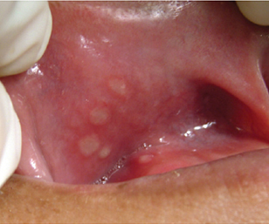
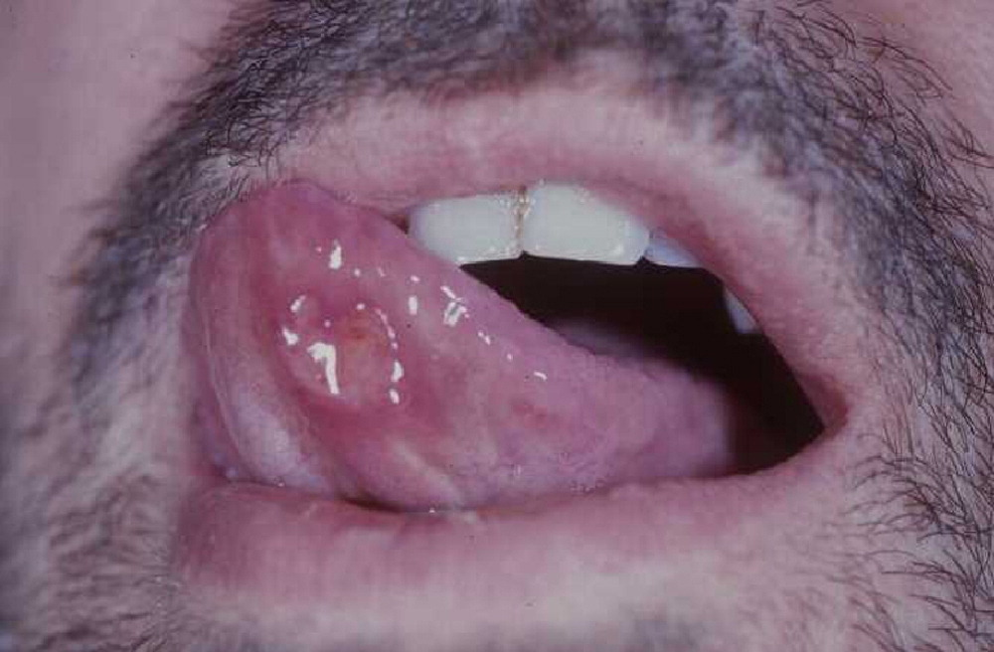
Notes:
Oral aphthae (Initial feature)
Occur in crops of 3 to 10 or more lesions
Occur on the Buccal mucosa, Gingiva, Lips, and Tongue
Aphthae begin as painful papules which rapidly progress to shallow ulcerations with worsening pain with white to yellow pseudo membrane adheres to the surface of the ulcer.
Heal spontaneously without scarring during 1 to 3 weeks.
Genital ulcers
Occur on the scrotum and penis in males and on the vulva or vaginal mucosa in females
Similar in appearance to oral lesions, but with greater tendency to scar
Resolve during 2 to 4 weeks, and may recur less frequently than oral ulcers.
HSV should be excluded by viral culture or PCR before the lesions are accepted as a diagnostic criterion for Behçet's’

Slide 8
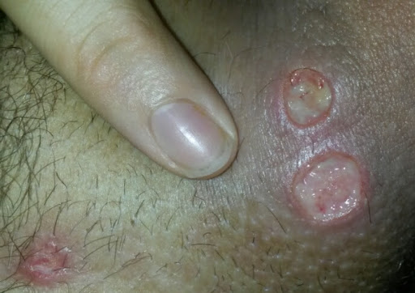
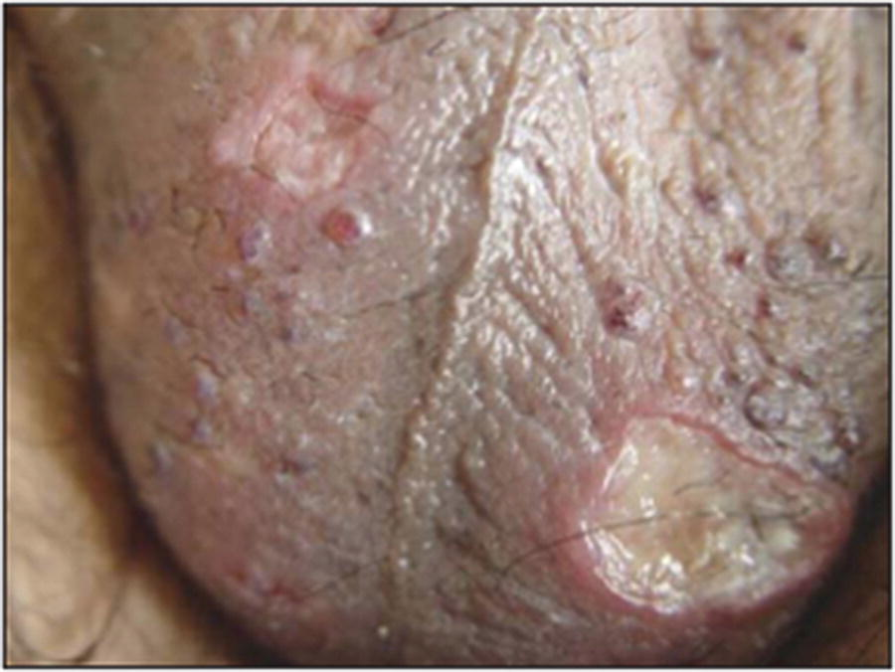
Genital ulcers(60–80%) - More Specific

Slide 9
Skin Lesions
Skin lesions
Erythema nodosum
Acneiform lesions
Migratory thrombophlebitis
Vasculitis

Slide 10
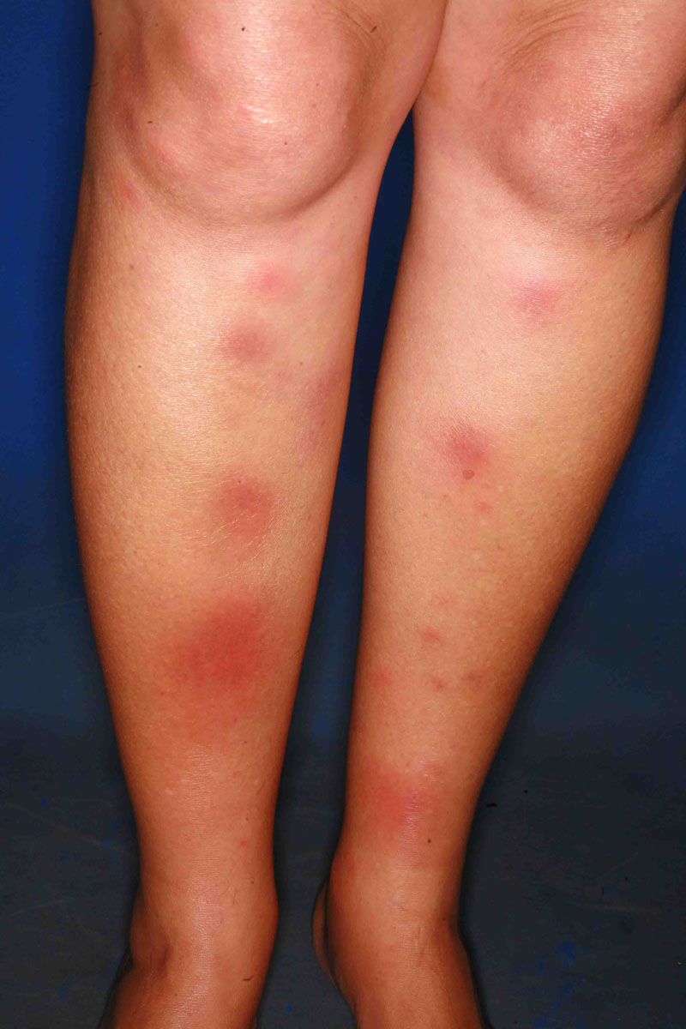
Erythema Nodosum

Slide 11
Acneiform lesions

Slide 12
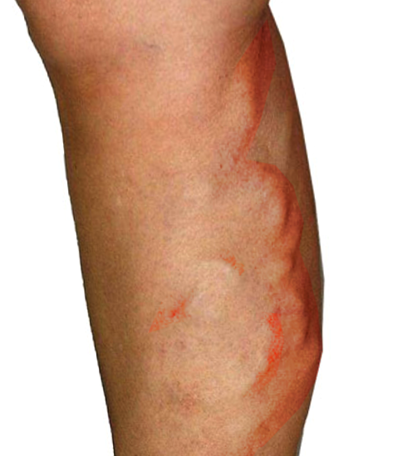
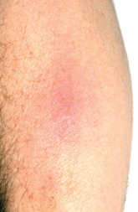
Migratory Thrombophlebitis

Slide 13
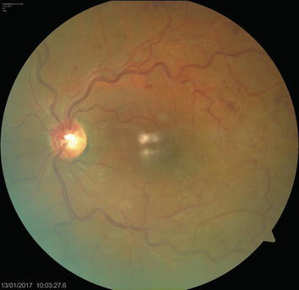
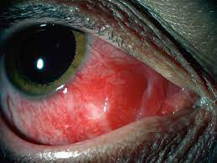
Ocular involvement is common
Anterior or posterior uveitis
Retinal vasculitis
Notes:
Retinal vasculitis can be concluded as a finding such as an intraretinal hemorrhage or cotton wool exudate. Intraretinal hemorrhage indicates an abnormality of retinal vessel wall. Cotton wool exudates indicate local retinal ischemia caused by occlusive vasculitis. In BD with RV, patchy perivascular sheathing and whitish yellow exudates surrounding retinal hemorrhages are often observed. Severe RV can result in ischemic changes due to vascular occlusion. Choroidal vascular involvement also occurs, and choroidal infarcts can also be seen

Slide 14
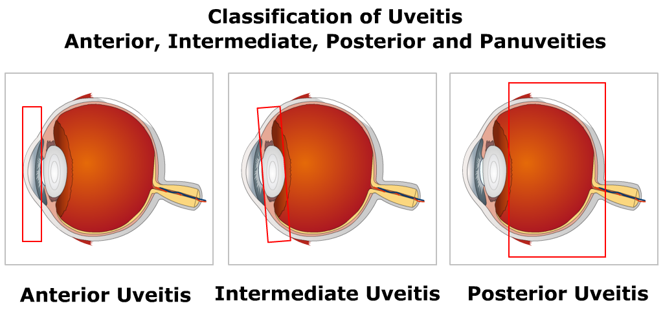

Slide 15
Hypopyon in a patient with Behçet’s disease

Slide 16
Arthritis
Nonerosive, inflammatory, symmetric, or asymmetric oligoarthritis
The most commonly involved joints are the knees, ankles, wrists and elbows with associated enthesopathy

Slide 17
Neurological Involvement (5%)
Involves mainly the brainstem, but the meninges, hemispheres and cord can also be affected, causing pyramidal signs, cranial nerve lesions, brainstem symptoms or hemiparesis

Slide 18
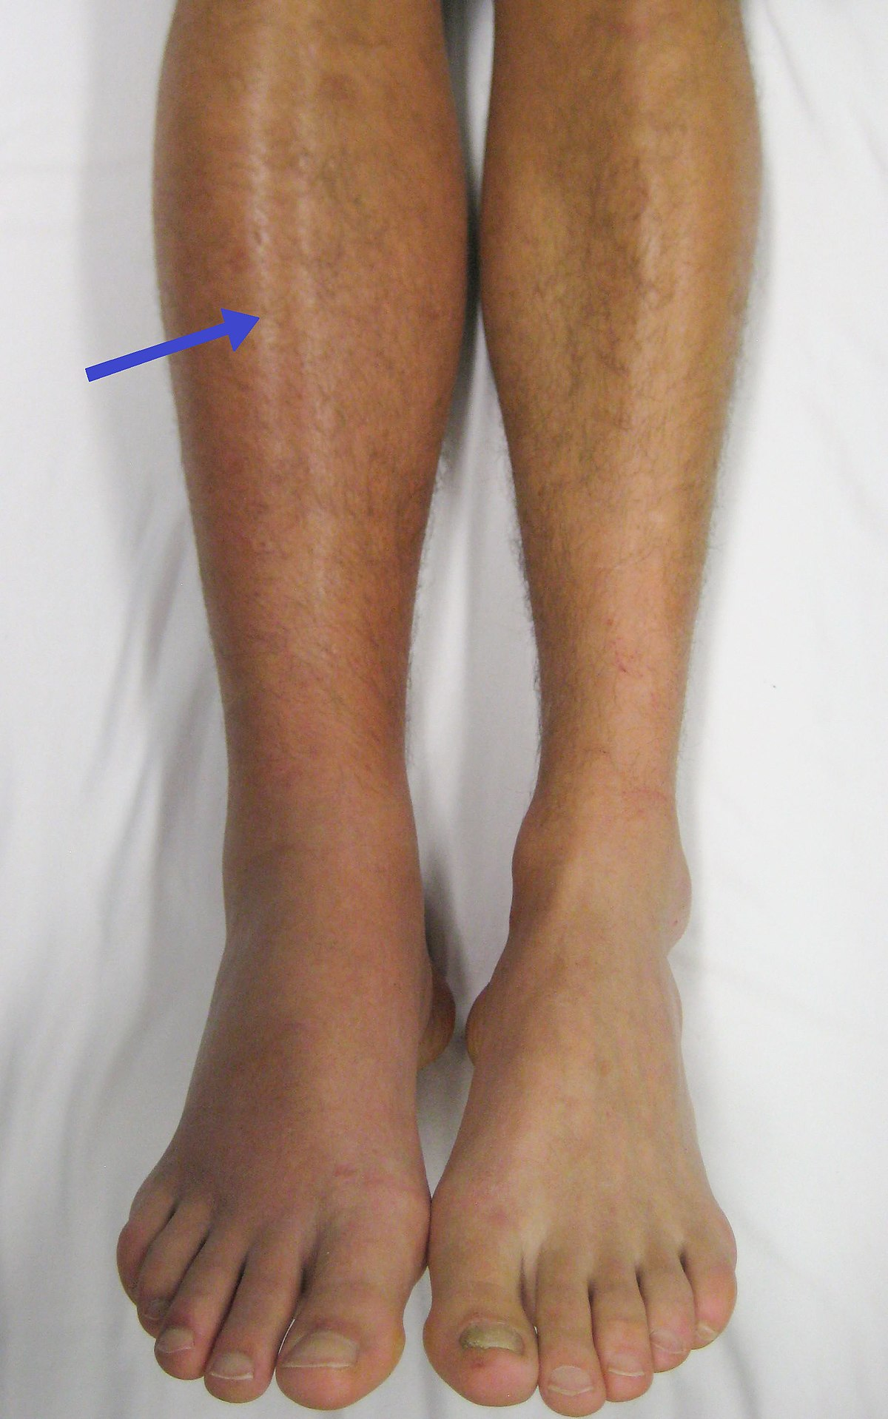
Recurrent thromboses also occur
Renal involvement is extremely rare

Slide 19
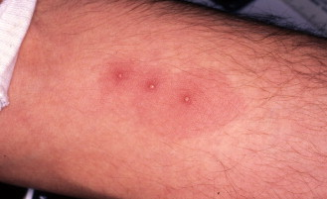
Diagnosis
Primarily made on clinical grounds
Pathergy test (may be of diagnostic value) which involves pricking the skin with a needle and looking for evidence of pustule development within 48 hours

Slide 20
Diagnostic criteria
Recurrent Oral Ulceration
Minor aphthous, major aphthous or herpetiform ulceration at least three times in 12 months
Plus two of the following
Recurrent genital ulceration
Eye lesions: anterior uveitis, posterior uveitis, cells in vitreous on slit-lamp examination, retinal vasculitis
Skin lesions: erythema nodosum, pseudofolliculitis, papulopustular lesions, acneiform nodules
Positive Pathergy Test

Slide 21
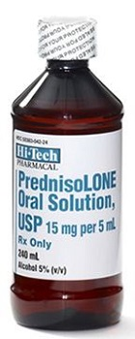
Treatment
Oral ulceration can be managed with
Topical glucocorticoid preparations (soluble prednisolone mouthwashes, glucocorticoid pastes)

Slide 22
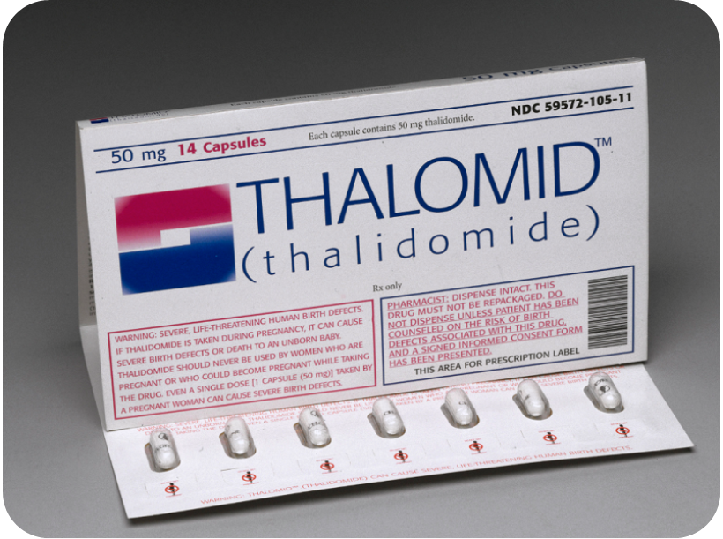
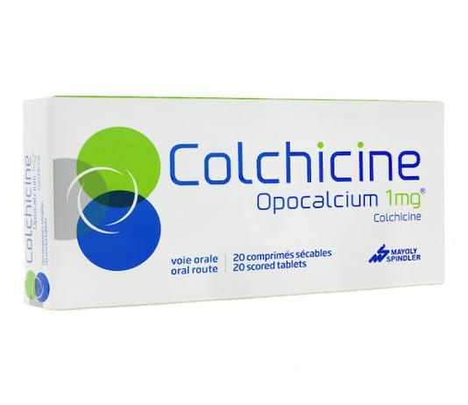
Colchicine can be effective for erythema nodosum & arthralgia
Thalidomide (100–300 mg per day for 28 days initially) is very effective for resistant oral and genital ulceration but is teratogenic and neurotoxic

Slide 23
Systemic Disease
Systemic corticosteroids alone or in combination with other immunosuppressive agents such as azathioprine, cyclosporine, cyclophosphamide & IFN-α
Eye Disease
The standard of care is prednisone plus azathioprine
If this combination is not successful, one of the mentioned immunosuppressive agents or mycophenolate mofetil can be substituted for azathioprine

Slide 24
